Slide 1
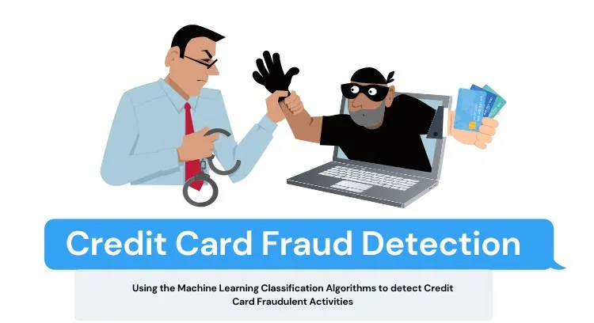
CREDIT CARD FRAUD DETECTION
Submitted by :-
Shreshth Vyas
Sanika Behere
Gaurav Singh Bisht

Slide 2
Agneda
Objective/Problem Statement
Background
Problem Solving Approach
Key Insights/ Visualization
Cost Benefit Analysis
Appendix:
Data Methodology
Attached Files

Slide 3
Objective/ Problem Statement
As a part of the analytics team working on a fraud detection model and its cost-benefit analysis. We need to develop a machine learning model to detect fraudulent transactions based on the historical transactional data of customers with a pool of merchants.
We have to analyse the business impact of these fraudulent transactions and recommend the optimal ways that the bank can adopt to mitigate the fraud risk.
We need to put proactive monitoring and fraud prevention mechanisms in place
Machine Learning help these institutions to reduce time consuming manual reviews, costly chargebacks and fees, and denial of legitimate transaction.

Slide 4
Background
In recent times, the number of fraud transactions has increased drastically, due to which credit card companies are facing a lot of challenges. For many banks, retaining high profitable customers is the most important business goal.
In terms of substantial financial loss, trust and credibility, banking fraud is a concerning issue for both banks and customers alike.
With the rise in digital payment channels, the number of fraudulent transactions is also increasing as fraudsters are finding new and different ways to commit such crimes.
We have performed the root causes analysis for the increasing number of frauds and high revenue loss, and you realized that building a fraud detection system using different machine learning techniques is quite important to identify such fraudulent activities at the right time and prevent them from happening.

Slide 5
Problem- Solving Approach
Reading and Understanding the data.
Data Cleaning / Transformation
EDA (Univariate and Bivariate Analysis)
Train/ Test Data Splitting.
Build models with various techniques
Business Impact :- Cost Benefit Analysis.
Validate model with Recall & AUC
Model Fitting
on Test/unseen Data
Validate model with Recall & AUC

Slide 6
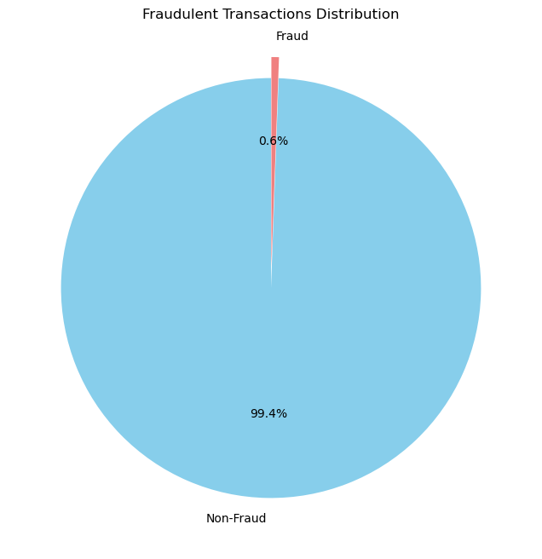
Key Insights/Visualization
Data set is highly imbalanced. Out of a total transaction 9651 are fraudulent i.e. 0.6% of the total transactions.

Slide 7
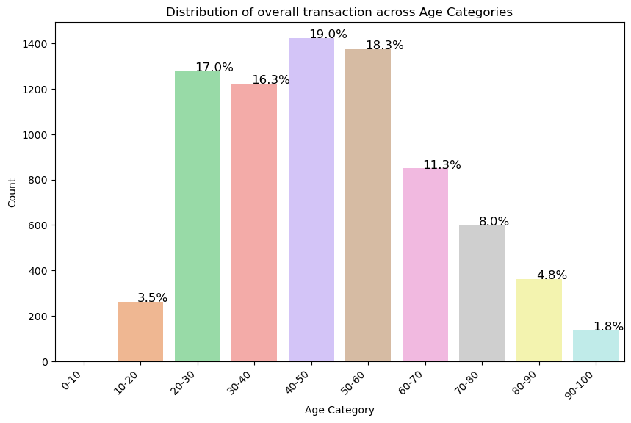
Mid Age People between 30 – 60 have the most number of fraudulent activities.

Slide 8
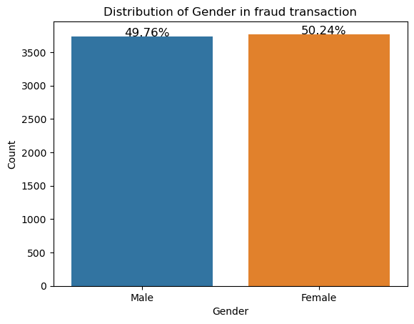
Female having more Fraudulent transaction count over Man although the difference is not huge.

Slide 9
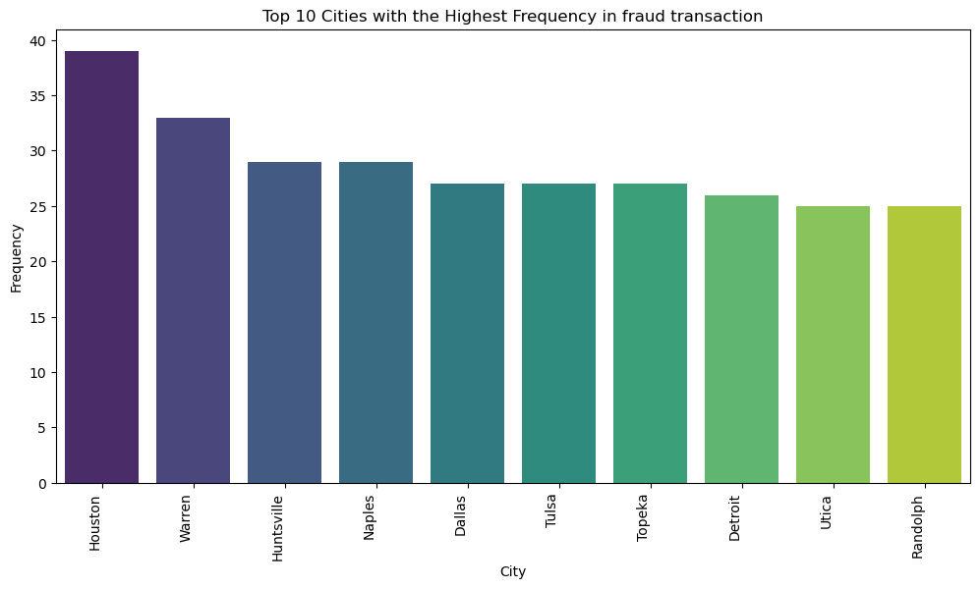
Top 10 Cities with highest number of fraudulent activites.

Slide 10
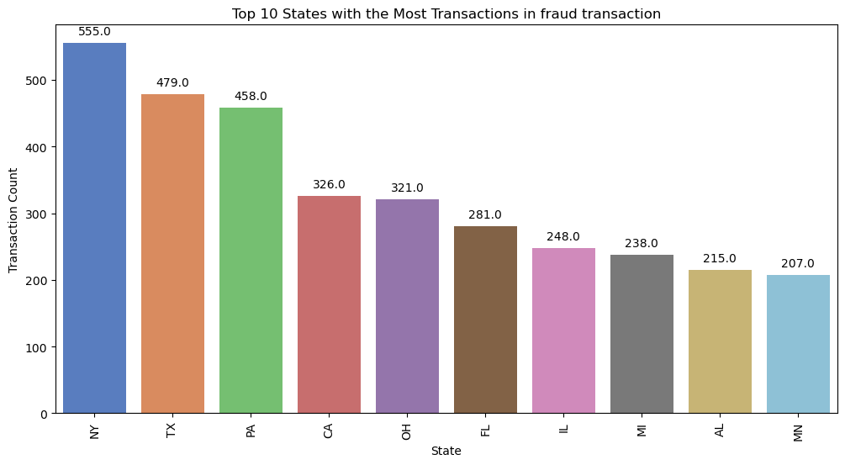
These are the top 10 states where most number of fraudulent activities occured.

Slide 11
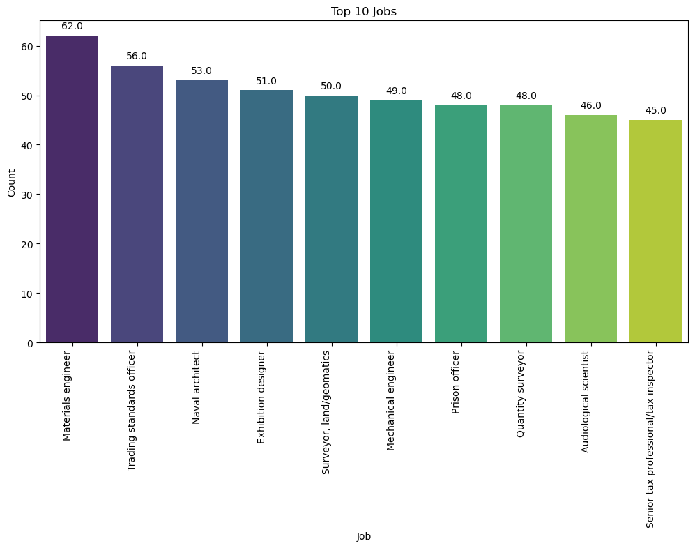
These are the top 10 jobs on whom most number of fraudulent activities occurred.

Slide 12
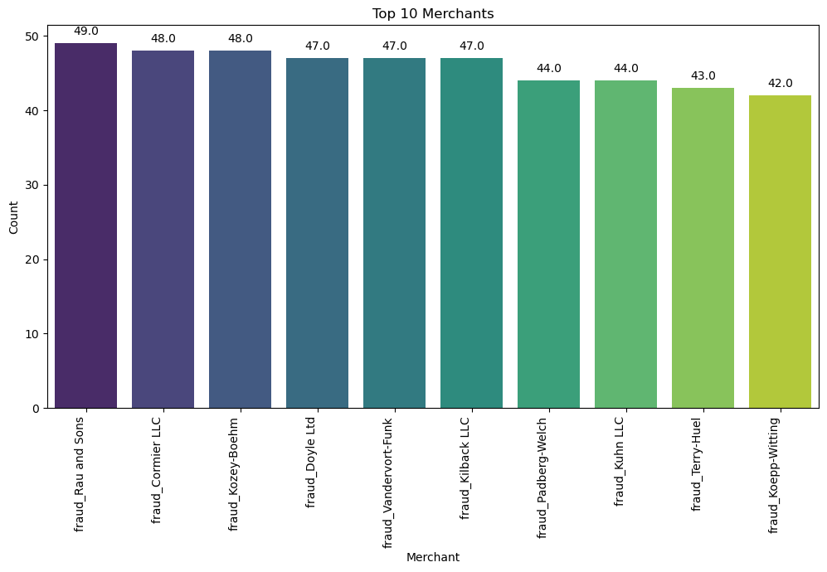
These are the top 10 merchant on whom most number of fraudulent activities occurred.

Slide 13
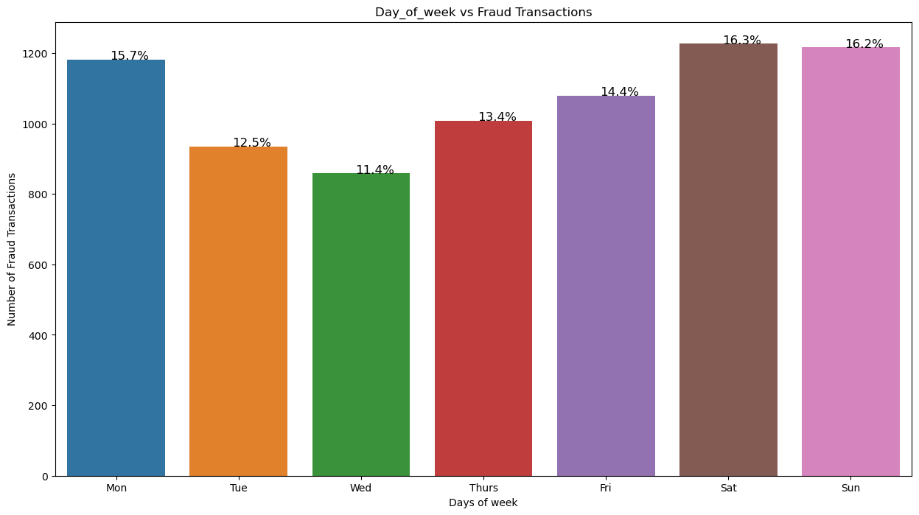
Most number of fraudulent activities occurred on Monday, Saturday and Sunday.

Slide 14
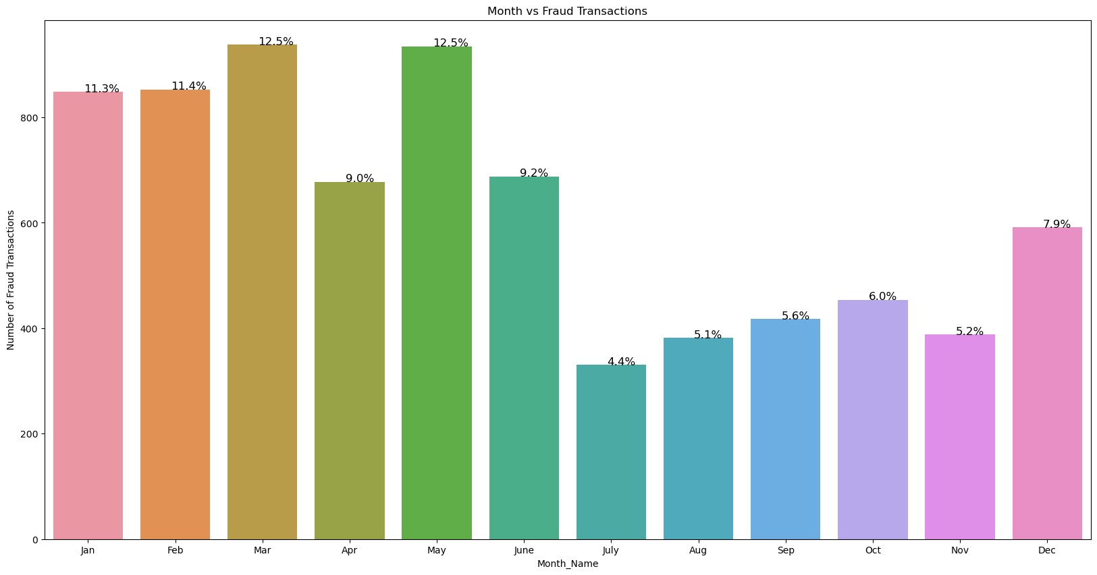
Most number of fraudulent activities occurred in First 6 month.

Slide 15
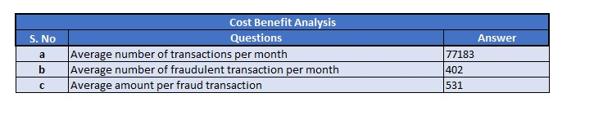
Cost Benefit Analysis
Part 1 – Cost Benefit Analysis

Slide 16
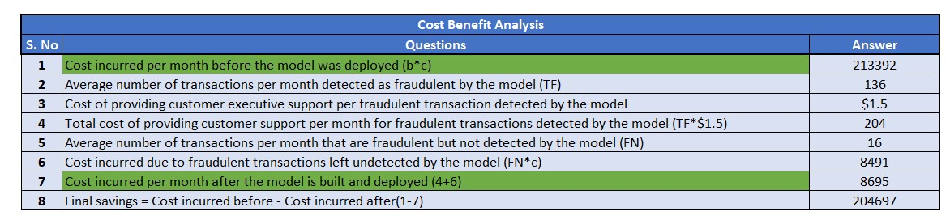
Part 2 – Cost Benefit Analysis

Slide 17
Appendix : Data Methodology
Multiple Machine Learning Model Classifier were built on the top of the provided dataset.
Class Imbalance was adjusted using Adaptive Synthetic (ADASYN) sampling method.
Manual Hyperparameter tuning is done due to extensive computational times when we are using Grid Search Cross Validation.
Using ADASYN Sampling method in training the data ,we found the significant result, so we used ADASYN sampling method for unseen data.

Slide 18
Appendix : Attached Files
Cost Benefit Analysis:
Cost+Benefit+Analysis.xlsx.
Multiple Machine Learning Model Deployments:
project final.ipynb
Video Submission Link :
https://drive.google.com/file/d/1opC0m2A33xPSsGNy5yZUjY5vwnLmzshY/view?usp=sharing

Slide 19


